Slide 1
CS5187: Vision & Image
Zhu Zhiyu
Tutorial 02: Edge Detection & Image Resampling
Notes:
How about now?

Slide 2
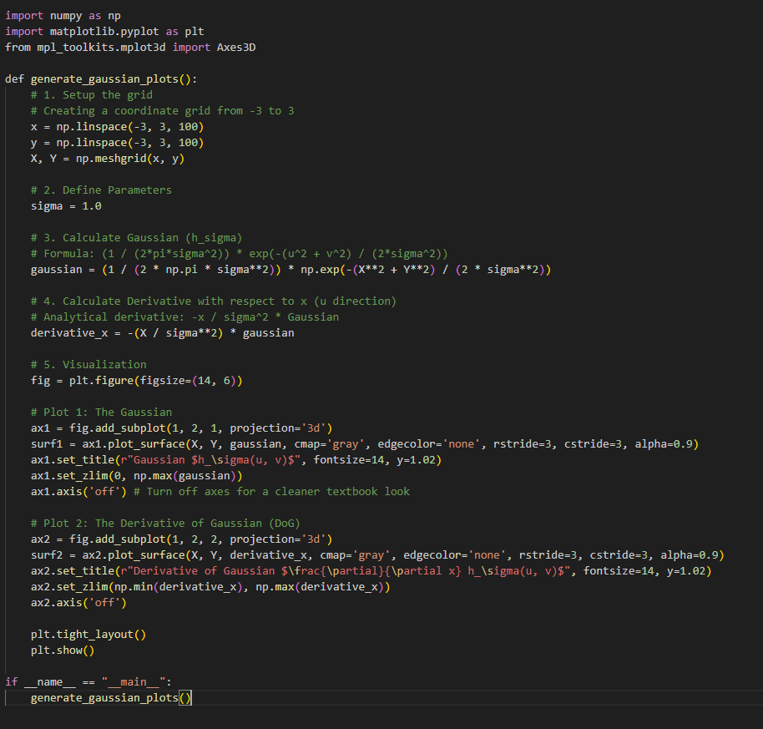
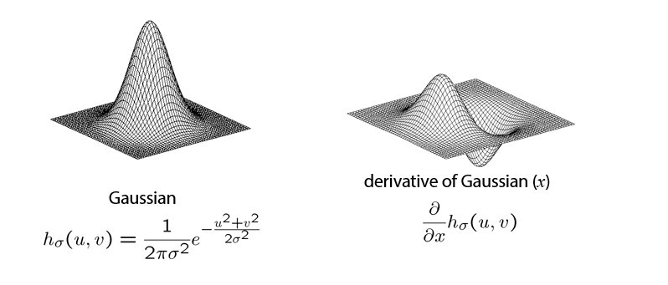
（1）Visualize the Gaussian Kernel and its derivative
Notes:
First, we should talk about what an image is.

Slide 3
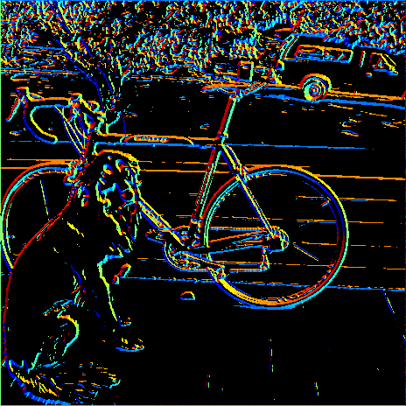
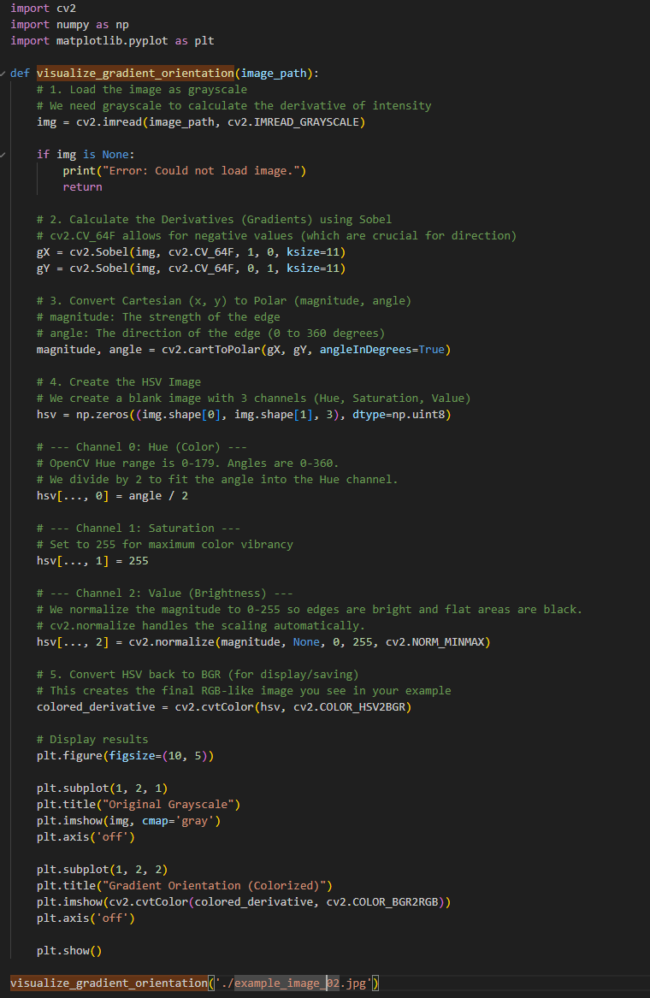
（2）Sobel filtering the edges in the image
θ = atan2(gy, gx)
360
0
Notes:
First, we should talk about what an image is.

Slide 4
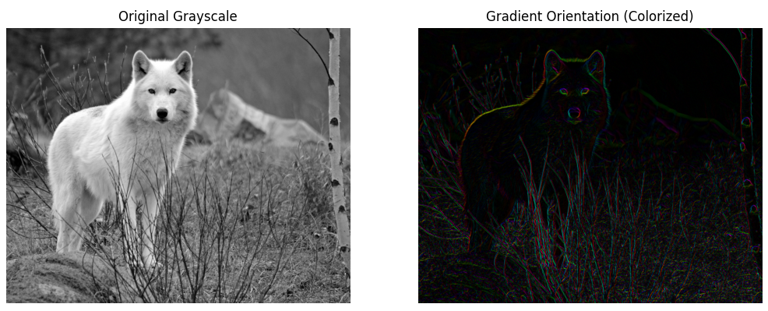
（2）Sobel filtering the edges in the image
Notes:
First, we should talk about what an image is.

Slide 5
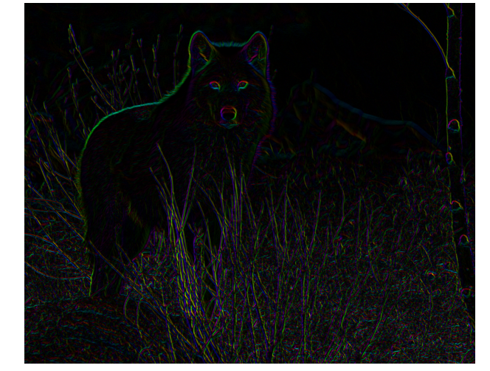
（3）Question: visualize the edge orientation
Edge Orientation V.S. Gradient Orientation
Notes:
First, we should talk about what an image is.

Slide 6
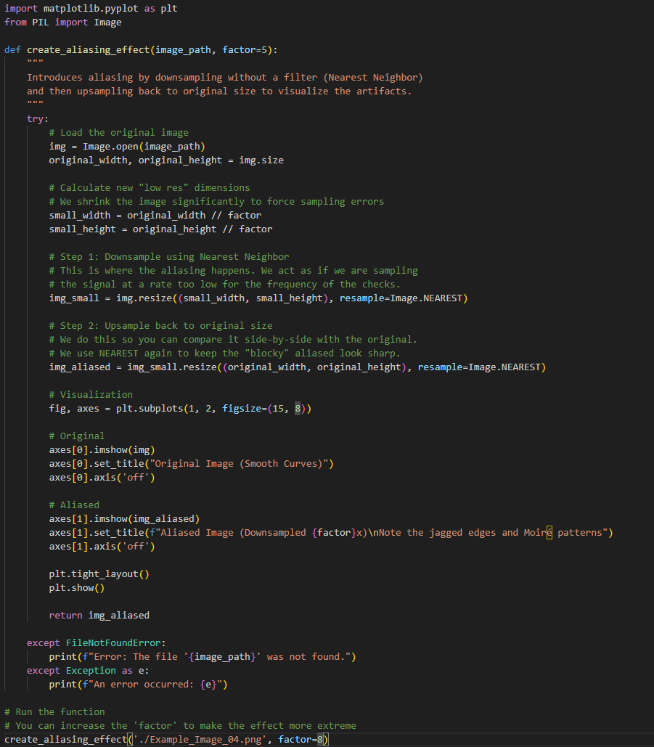
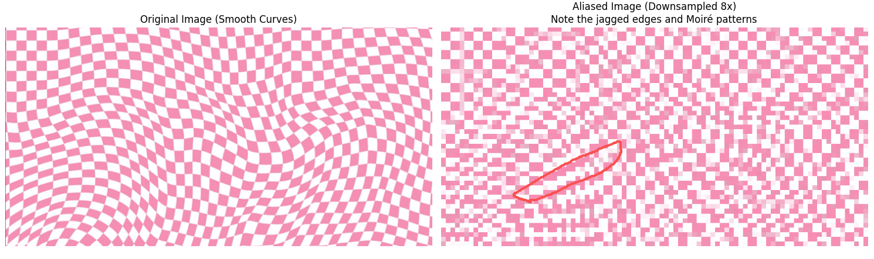
（4）Image Resampling: Visualizing Aliasing
Notes:
First, we should talk about what an image is.

Slide 7
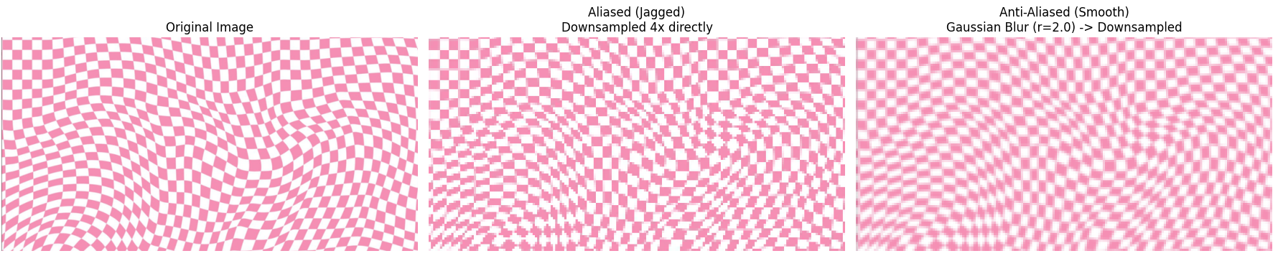
（5）Robust Resampling with Gaussian Blur
Notes:
First, we should talk about what an image is.

Slide 8
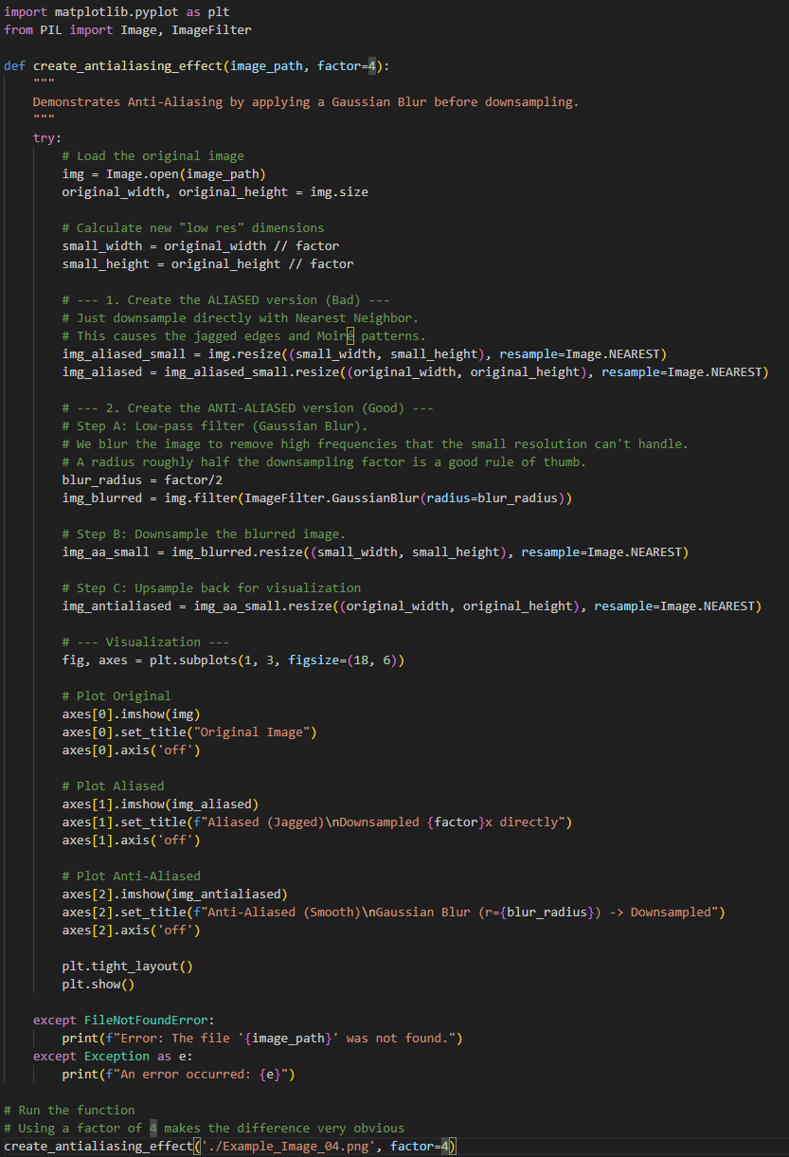
（5）Robust Resampling with Gaussian Blur
Notes:
First, we should talk about what an image is.

Slide 9
Questions?

